Slide 1
THE HUMAN FALL
What is the origin of evil?

Slide 2
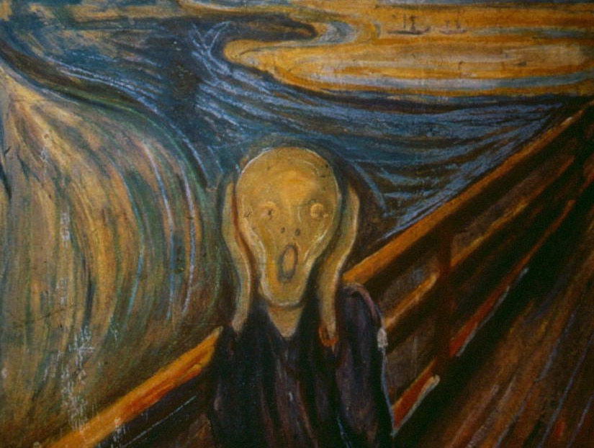
“No one has known the root of sin, which lies deep within and ceaselessly drives people toward the way of evil.”
—DP p.53

Slide 3


Force of Principle
Force of Love

Slide 4
Force of Principle
Force of Love

Slide 5
The 3 Blessings
The Commandment
“Do Not Eat the Fruit of Good & Evil”
God’s Guidance +
Force of Principle
Force of Love

Slide 6
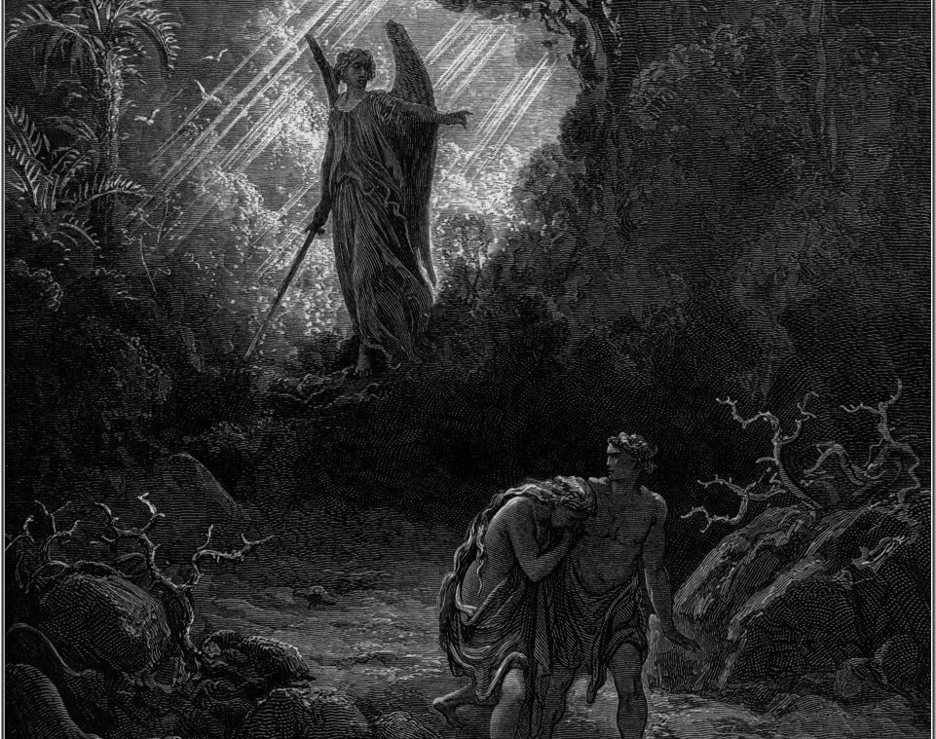
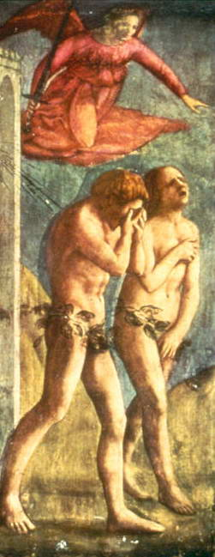

Slide 7

THE GENESIS STORY OF THE HUMAN FALL
Tree of the Knowledge of Good and Evil
Tree of Life
Fruit
Serpent
Adam
Eve

Slide 8
“FRUIT”— not literal
“…not what goes into the mouth defiles a man, but what comes out of the mouth, this defiles a man…
what comes out of the mouth proceeds from the heart, and this defiles a man. For out of the heart come evil thoughts, murder, adultery, fornication, theft, false witness, slander. These are what defile a man…”
—Matthew 15:10-11

Slide 9
THE GENESIS STORY OF THE HUMAN FALL
Tree of the Knowledge of Good and Evil
Tree of Life
Fruit
Serpent
Adam
Eve
Romans 11:17
“… and thou, being a wild olive tree, were grafted in among them …”
Romans 11:24
… and wert grafted contrary to nature into a good olive tree [Christ] …”

Slide 10

Good
SEXUAL LOVE =
Evil

Slide 11
“SERPENT”
₌
ARCHANGEL
LUCIFER
“And the great dragon was thrown down, that ancient serpent, who is called the Devil and Satan, the deceiver of the whole world—he was thrown down to the earth, and his angels were thrown down with him.”
Revelation 12:9

Slide 12
Sin of the Angels
“And the angels that did not keep their own position but left their proper dwelling have been kept by him in eternal chains in the nether gloom until the judgment of the great day; just as Sodom and Gomorrah and the surrounding cities, which likewise acted immorally and indulged in unnatural lust, serve as an example by undergoing a punishment of eternal fire.”
—Jude 6-7
Sin of Adam & Eve
“Naked…and not ashamed”
—Genesis 2:25
“Covered their nakedness”
—Genesis 3:7

Slide 13
Illicit
Physical Love
Illicit
Spiritual Love
ADAM
EVE
ARCHANGEL

Slide 14
What was the process and motivation behind the first fallen act?

Slide 15
POSITION OF ANGELS: SERVANTS
“All angels [are] ministering spirits sent to serve [man]…”
—Hebrews 1:14
“We will judge the angels.”
—1 Corinthians 6:3
“Pray then like this: our Father who art in heaven, hallowed by thy name,…”
—Matthew 6:9
POSITION OF MAN AND WOMAN: CHILDREN

Slide 16

Before the Creation of Man and Woman
God
Servant
Lucifer
Creation
Angels

Slide 17
God
Servant
AA
Creation
Angels
A/E

Slide 18
JEALOUSY
DIRECTION DECIDES GOOD OR EVIL
Improve self GOOD
Destroy rival EVIL

Slide 19
SPIRITUAL FALL
“When the angel, created as God’s servant, beheld Eve, the daughter of God, it was only natural that she looked beautiful in his eyes.”
—DP p.64
Illicit Love
Spiritual
Only
EVE
ARCHANGEL

Slide 20
What was the process and motivation behind the second fallen act?

Slide 21
PHYSICAL FALL
Illicit Relationship
Both
Spiritual & Physical
ADAM
EVE
LUCIFER

Slide 22
The Results of the Fall

Slide 23
“When the first human ancestors fell, they bound themselves in blood ties with Lucifer. They formed a four position foundation yoked to Satan, and thus all humanity became the children of Satan.”
—DP p. 68

Slide 24
Original Sin
“You are of your father the devil, and your will is to do your father’s desires.”
John 8:44
Satan
Fallen
Adam
False
Love
Fallen
Eve
Fallen
Descendants

Slide 25
Satan took God’s position
“…the god of this world has blinded the minds of the unbelievers”
2 Cor: 4:4
Satan
Fallen
Adam
False
Love
Fallen
Eve
Fallen
Descendants

Slide 26
TWO OPPOSING NATURES
Selfish Love Seeks my happiness at the expense of others
True Love Finds happiness in the happiness of others
Fallen
Nature
Original Nature
Everyone is struggling

Slide 27
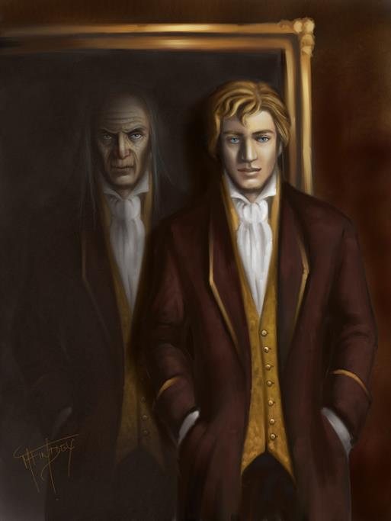

Slide 28
FOUR FALLEN NATURES

Slide 29
FOUR FALLEN NATURES
Not loving from God’s viewpoint (Example: Self-centered love)

Slide 30
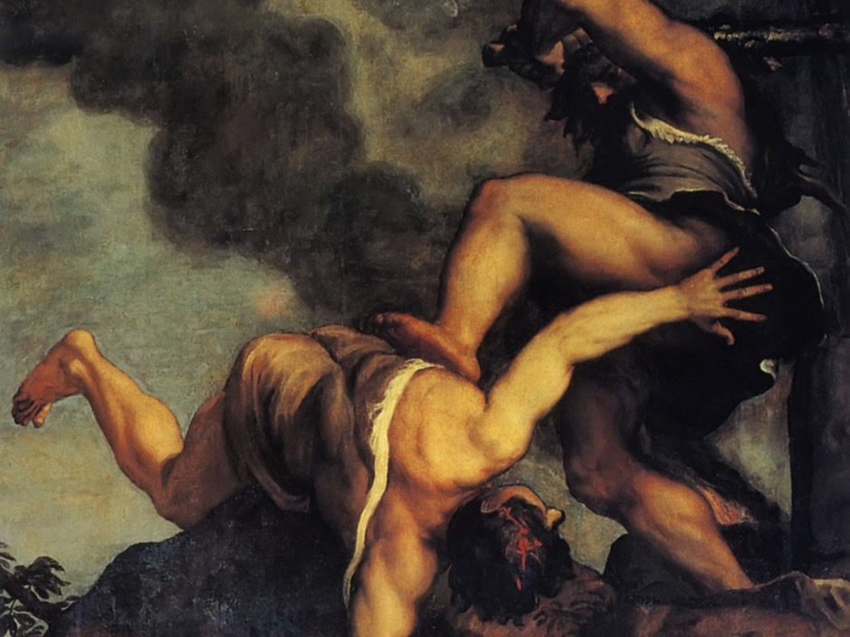

Slide 31
FOUR FALLEN NATURES
Not loving from God’s viewpoint (Example: self-centered)
Leaving our position of responsibility
(Example: improper sexual desires)

Slide 32
FOUR FALLEN NATURES
Not loving from God’s viewpoint (Example: self-centered)
Leaving our position of responsibility
(Example: improper sexual desires)
Reversing the order of authority
(Example: our bodily desires dominate us)

Slide 33
FOUR FALLEN NATURES
Not loving from God’s viewpoint (Example: self-centered)
Leaving our position of responsibility
(Example: improper sexual desires)
Reversing the order of authority (Example: dominance of our bodily desires)
Multiplication of evil
(Example: hiding my sin)

Slide 34
God
AA
Husband
True Love
Wife
Husband
FalseLove
Wife
Child
Child
Family
Society
Nation
One World
Family
Family
Society
Nation
One World
Family

Slide 35
“God was grieved that he had made man, and his heart was filled with pain.”
—Genesis 6:6

