Slide 1
Restoration

Slide 2
God
Adam
Eve
Fall
AA
Evil History
Adam
Eve

Slide 3
The External Dimension of History
Individual Family Society Nation Bloc
Individual Family Society Nation Bloc
Land Power Beliefs
THE INTERNAL DIMENSION OF HISTORY
Humanity
God
Satan

Slide 4
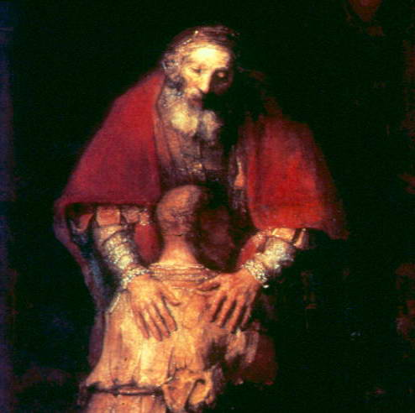
History
The untold story of
God’s effort to save His children

Slide 5
God
Adam
Eve
Fall
Restoration History
AA
Evil History
Adam
Eve

Slide 6
God
Messiah
True Parents
New Adam
New
Eve
Adam
Eve
Fall
Restoration History
AA
Adam
Eve

Slide 7
God
God
Messiah
Bride
Child
Messiah
True Parents
New Adam
New
Eve
Adam
Eve
Fall
Restoration History
AA
Adam
Eve

Slide 8
God’s Will = 95% God’s Portion of Responsibility
+ 5% Human Portion of Responsibility
Fallen
Person
God
Satan
Good Conditions
Sin
The success or failure in God’s providence depends on the conditions that people make

Slide 9
God
Messiah
True Parents
New Adam
New
Eve
Adam
Eve
Fall
Restoration History
AA
Adam
Eve

Slide 10
God
Messiah
True Parents
New Adam
New
Eve
Fall
Foundation
Adam
Eve
Restoration History
AA
Adam
Eve

Slide 11
INDEMNITY CONDITIONS
To reverse the conditions that put us into our fallen state
Original
Position
Lost
Restored
Fallen
Position

Slide 12
Restoration through Indemnity – Reverse the Fall
2 Elements in the Fall
Adam
Eve
1) Loss of Faith
Fall
2) Acquired Fallen Nature
AA
Adam
Eve

Slide 13
Indemnity Condition to Reverse the Fall
2 Elements in the Fall
2 Elements in Restoration
Adam
Eve
1) Loss of Faith
Fall
Restore Faith
Reverse
Fallen Nature
2) Acquired Fallen Nature
AA
Adam
Eve

Slide 14
Indemnity Condition to Reverse the Fall
2 Elements in the Fall
New Adam
New
Eve
Messiah
Adam
Eve
1) Loss of Faith
Fall
Restore Faith
Reverse
Fallen Nature
2) Acquired Fallen Nature
AA
Adam
Eve

Slide 15
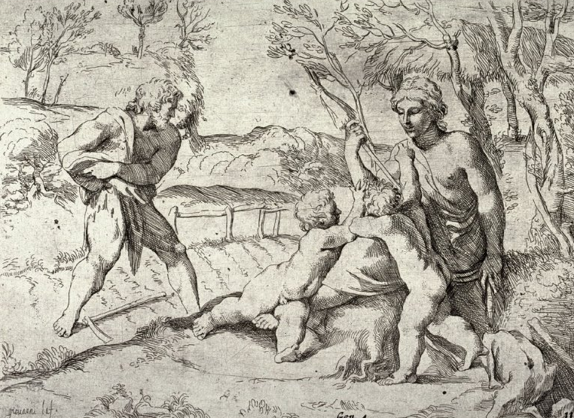
Restoration: Adam’s Family

Slide 16
Restoration: Adam’s Family
Adam
Eve
Restore Faith
2) Reverse Fallen Nature
- Abel’s Offering
Cain & Abel Unite

Slide 17
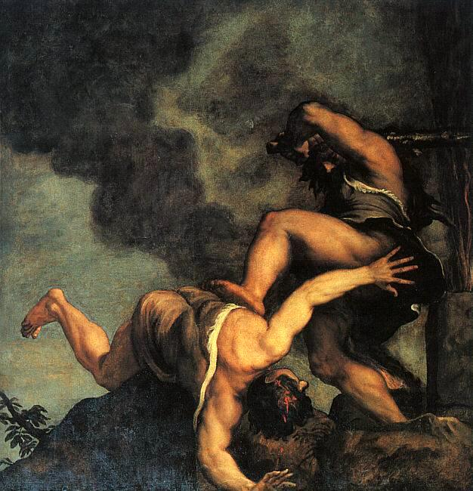

Slide 18
Restoration through Noah’s Family
Adam
Eve
Restore Faith
2) Reverse Fallen Nature
- Noah’s Offering
Noah’s Children Unite

Slide 19
Restoration through Abraham’s Family
Adam
Eve
Restore Faith
2) Reverse Fallen Nature
- Abraham & Isaac
Esau & Jacob

Slide 20
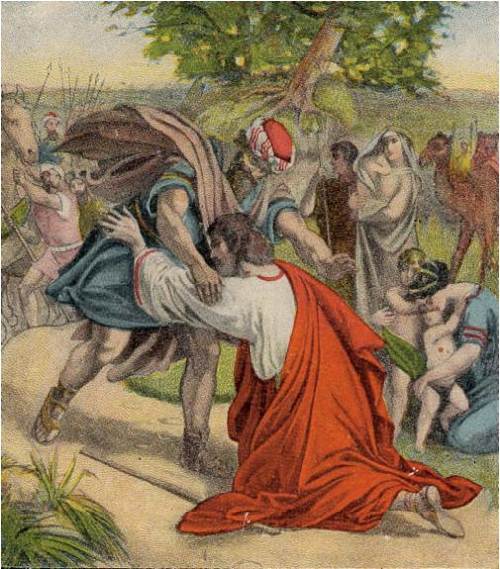

Slide 21
Restoration through Abraham’s Family
Israel
Adam
Eve
Restore Faith
2) Reverse Fallen Nature
- Abraham & Isaac
Esau & Jacob

Slide 22
Restoration through Moses
National Foundation
Adam
Eve
Restore Faith
2) Reverse Fallen Nature
Moses’ Offering
3 x 40 years
Israelites Unite with Moses

Slide 23
Restoration through Moses
National Foundation
Adam
Eve
Restore Faith
2) Reverse Fallen Nature
Moses’ Offering
3 x 40 years
Israel Unites with Moses

Slide 24
WORD
Abraham
Moses
Jesus
400
Slavery in
Egypt

Slide 25
WORD
WORD
Saul David
Solomon
Abraham
Moses
Jesus
120
400 | 400
Slavery in
Egypt
United Kingdom

Slide 26
WORD
WORD
Saul David
Solomon
Abraham
Moses
Jesus
120
400 | 400
Slavery in
Egypt
United Kingdom

Slide 27
WORD
WORD
Saul David
Solomon
Elijah
Prophets
Abraham
Moses
Jesus
120
400 | 400 |  | 400
Slavery in
Egypt
United Kingdom
Divided Kingdom

Slide 28
WORD
WORD
Saul David
Solomon
Elijah
Prophets
Abraham
Moses
Jesus
120
400 | 400 |  | 400
Slavery in
Egypt
United Kingdom
Divided Kingdom

Slide 29
WORD
WORD
Saul David
Solomon
Elijah
Prophets
Abraham
Moses
Jesus
120
400 | 400 |  | 400 | 210
Slavery in
Egypt
United Kingdom
Divided Kingdom
Exile in Babylon

Slide 30
WORD
WORD
WORD
Saul David
Solomon
Elijah
Prophets
Return
Abraham
Moses
Jesus
120
400 | 400 |  | 400 | 210
Slavery in
Egypt
United Kingdom
Divided Kingdom
Exile in Babylon

Slide 31
WORD
WORD
WORD
Saul David
Solomon
Elijah
Prophets
Abraham
Moses
Malachi
Jesus
120
400 | 400 |  | 400 | 210 | 400
Slavery in
Egypt
United Kingdom
Divided Kingdom
Exile in Babylon

Slide 32
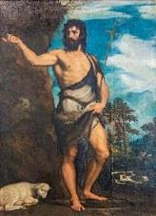
WORD
WORD
WORD
Saul David
Solomon
Elijah
Prophets
Abraham
Moses
Malachi
Jesus
120
400 | 400 |  | 400 | 210 | 400
Slavery in
Egypt
United Kingdom
Divided Kingdom
Exile in Babylon
John the Baptist

Slide 33
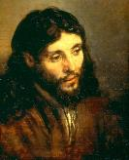
WORD
WORD
WORD
Saul David
Solomon
Elijah
Prophets
Abraham
Moses
Malachi
Jesus
120
400 | 400 |  | 400 | 210 | 400
Slavery in
Egypt
United Kingdom
Divided Kingdom
Exile in Babylon
SALVATION THROUGH JESUS
Believe in me John 6:28
Follow me Luke 18:18
Love me Matthew 10:37
John/Baptist
Jesus
God

Slide 34
WORD
WORD
WORD
Saul David
Solomon
Elijah
Prophets
Abraham
Moses
Malachi
Jesus
120
400 | 400 |  | 400 | 210 | 400
Slavery in
Egypt
United Kingdom
Divided Kingdom
Exile in Babylon
Satan
John/Baptist
Jesus
God

Slide 35
WORD
WORD
WORD
Saul David
Solomon
Elijah
Prophets
Abraham
Moses
Malachi
Jesus
120
400 | 400 |  | 400 | 210 | 400
Slavery in
Egypt
United Kingdom
Divided Kingdom
Exile in Babylon
Satan
John/Baptist
Jesus
God

Slide 36
WORD
WORD
WORD
Saul David
Solomon
Elijah
Prophets
Abraham
Moses
Malachi
Jesus
120
400 | 400 |  | 400 | 210 | 400
Slavery in
Egypt
United Kingdom
Divided Kingdom
Exile in Babylon
Satan
12 Apostles
Jesus
God

Slide 37
WORD
WORD
WORD
Saul David
Solomon
Elijah
Prophets
Abraham
Moses
Malachi
Jesus
120
400 | 400 |  | 400 | 210 | 400
Slavery in
Egypt
United Kingdom
Divided Kingdom
Exile in Babylon
Satan
12 Apostles
Jesus
God

Slide 38
WORD
WORD
WORD
Saul David
Solomon
Elijah
Prophets
Abraham
Moses
Malachi
Jesus
120
400 | 400 |  | 400 | 210 | 400
Slavery in
Egypt
United Kingdom
Divided Kingdom
Exile in Babylon
Satan
Humanity
Jesus
God

Slide 39
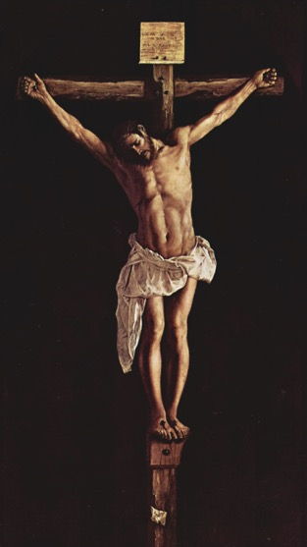
WORD
WORD
WORD
Saul David
Solomon
Elijah
Prophets
Abraham
Moses
Malachi
Jesus
120
400 | 400 |  | 400 | 210 | 400
Slavery in
Egypt
United Kingdom
Divided Kingdom
Exile in Babylon
Satan
Humanity
Jesus
God

Slide 40
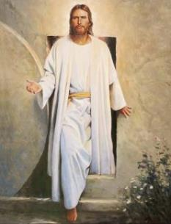
WORD
WORD
WORD
Saul David
Solomon
Elijah
Prophets
Abraham
Moses
Malachi
Jesus
120
400 | 400 |  | 400 | 210 | 400
Slavery in
Egypt
United Kingdom
Divided Kingdom
Exile in Babylon
Satan
Christians
God
Jesus

Slide 41
WORD
WORD
WORD
Saul David
Solomon
Elijah
Prophets
Abraham
Moses
Malachi
Jesus
120
400 | 400 |  | 400 | 210 | 400
Slavery in
Egypt
United Kingdom
Divided Kingdom
Exile in Babylon
Christianity
2nd Coming
400 | 400 | 120 | 400 | 210 | 400

Slide 42
Malachi
Moses
WORD
Saul
WORD
WORD
David
Solomon
Elijah
Prophets
Abraham
Jesus
120
400 | 400 |  | 400 | 210 | 400
Slavery in
Egypt
United Kingdom
Divided Kingdom
Exile in Babylon
NT WORD
NT WORD
Christianity
Martin Luther
2nd
Coming
Charlemagne
Persecution
In Rome
Christian Empire
Divided Christianity
Papal Exile
Preparation
400 | 400 | 120 | 400 | 210 | 400
800
1517
1917

Slide 43
Malachi
Moses
WORD
Saul
WORD
WORD
David
Solomon
Elijah
Prophets
Abraham
Jesus
120
400 | 400 |  | 400 | 210 | 400
Slavery in
Egypt
United Kingdom
Divided Kingdom
Exile in Babylon
NT WORD
NT WORD
WW I
WW II
WW III
Christianity
Martin Luther
Charlemagne
Persecution
In Rome
Christian Empire
Divided Christianity
Papal Exile
Preparation
400 | 400 | 120 | 400 | 210 | 400
800
1517
1917

Slide 44
Malachi
Moses
WORD
Saul
WORD
WORD
David
Solomon
Elijah
Prophets
Abraham
Jesus
120
400 | 400 |  | 400 | 210 | 400
Slavery in
Egypt
United Kingdom
Divided Kingdom
Exile in Babylon
NT WORD
NT WORD
WW I
WW II
WW III
Christianity
Martin Luther
Charlemagne
Persecution
In Rome
Christian Empire
Divided Christianity
Papal Exile
Preparation
400 | 400 | 120 | 400 | 210 | 400
800
1517
New Truth

